Slide 1
St. Patrick‘s Day Ludmila Růžičková

Slide 2
Basic information
17th March each year
It is Ireland's most important holiday
National holiday in Ireland
This holiday is popular in many countries
It is celebrated mainly by music, dance and wine drinking
Green colour is typical for this holiday - eat green food, wear green clothes
A typical symbol is a four leaf clover

Slide 3
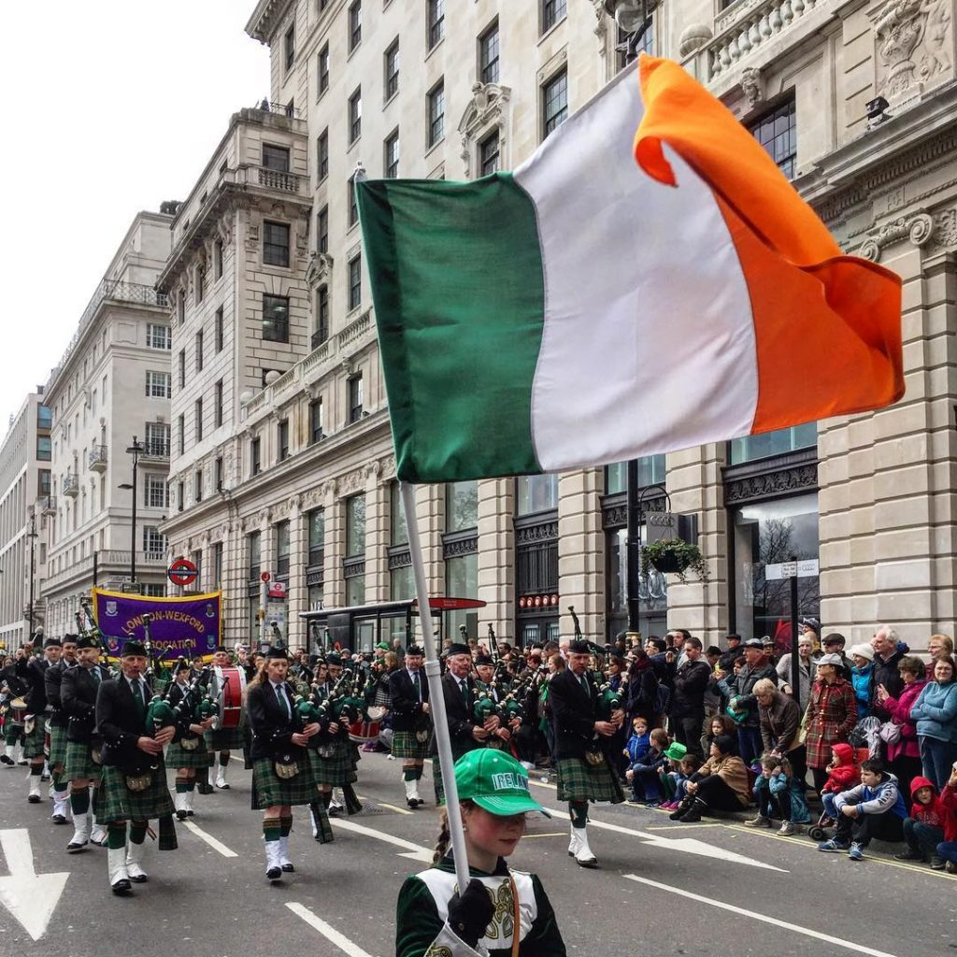
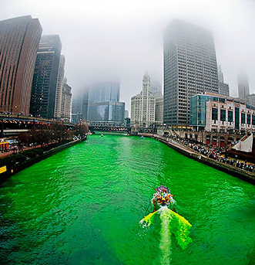

Slide 4
Interestingness
The tradition of dyeing food, beer or perhaps a green river does not come from Ireland. It is a specialty of St. Patrick's celebrations in the USA
Holiday food: Corned beef and cabbage, Irish soda bread
Until 1970 all pubs in Ireland closed during St. Patrick's Day. Traditional celebrations of this feast previously included a visit to the church.
Shamrock in whiskey - A popular Irish ritual is sinking shamrocks to the bottom of a glass. When we drink whiskey, we pull the shamrock out of the glass and throw it by the shoulder for good luck.

Slide 5
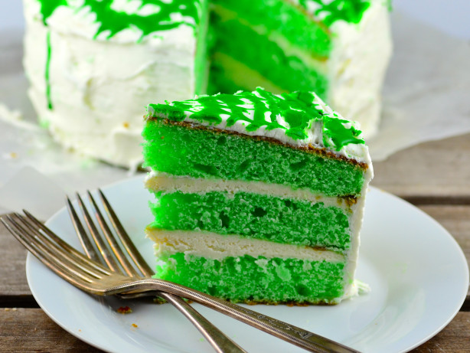
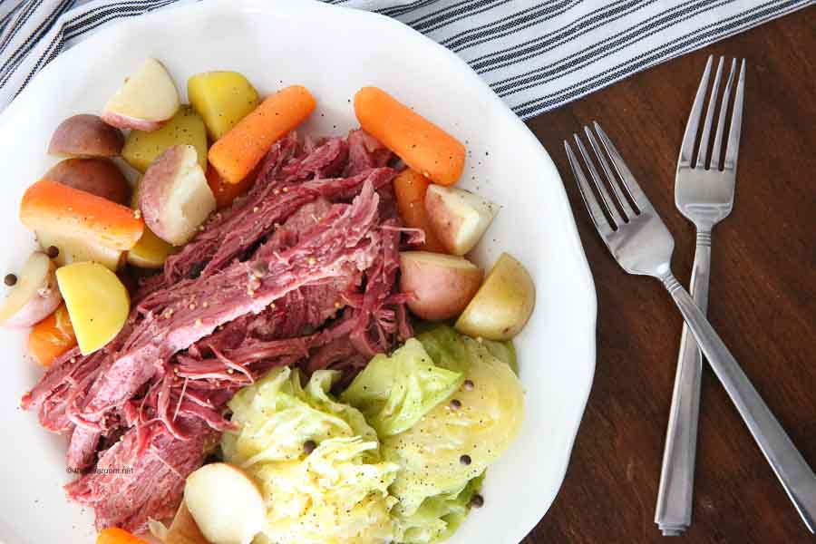

Slide 6
St. Patrick
He was an ancient Christian clergyman, monk, missionary and bishop
He wasn't of Irish origin, descended from Roman Britain
Its symbol is the green color and the shamrock shamrock with which he allegedly explained the Holy Trinity principle.
Is the patron saint of Ireland
according to legend, he expelled snakes from Ireland
Patrik is the patron saint of hairdressers, blacksmiths and miners.
At the top of Croagh Patrick supposedly St. Patrick was left without food for 40 days.

Slide 7
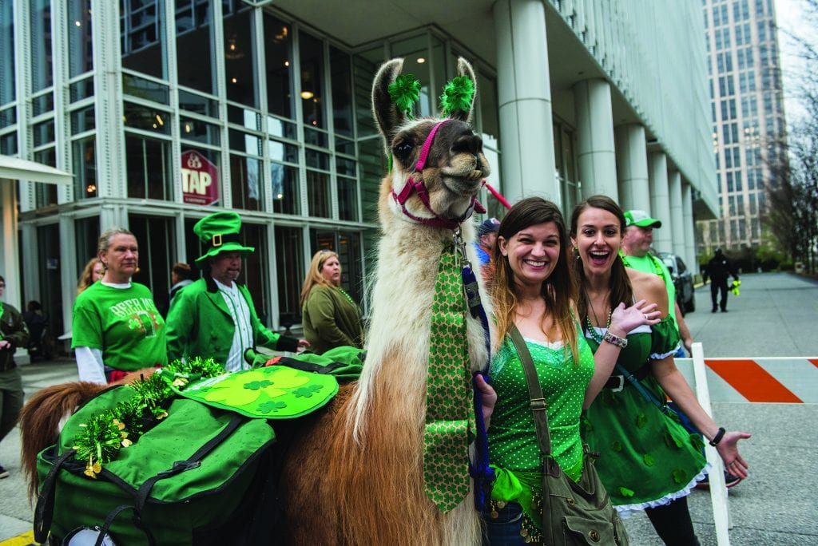
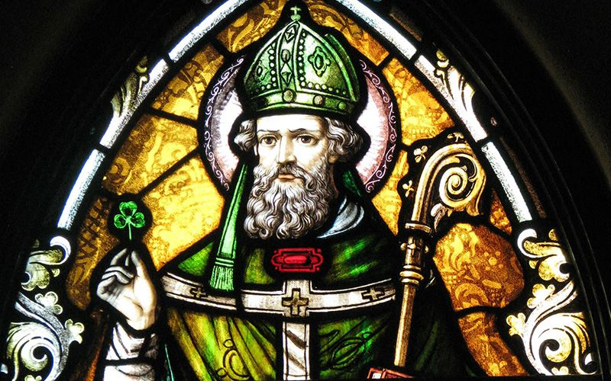

Slide 8
Thank you for your attention

