Slide 1
Saint Patrick‘s Day
Štěpánka Dejdarová

Slide 2
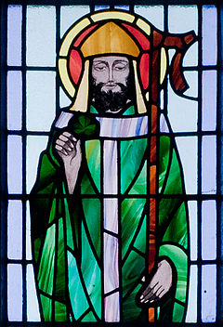
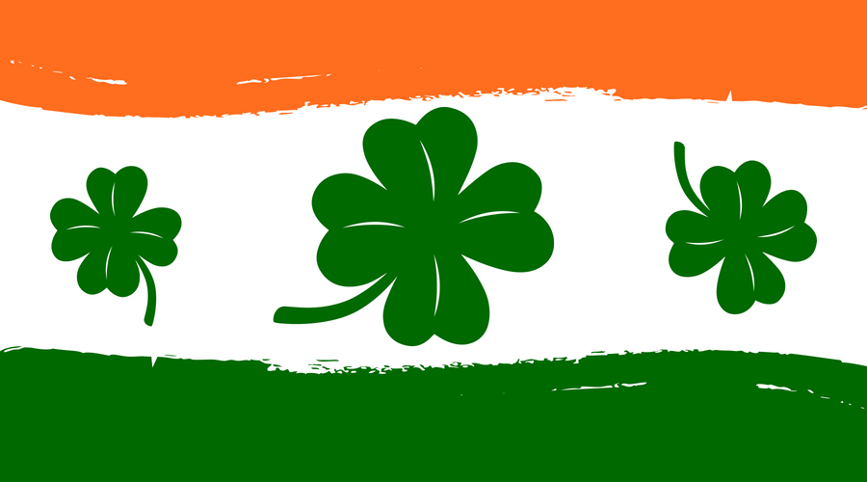
Basic Informations
It is a cultural and religious celebration held on 17th March, the traditional death date of Saint Patrick, the foremost patron saint of Ireland.
This day was made in the early 17th century.
Irish people celebrate Saint Patrick because he was probably the first one, who brought christianity to Ireland.

Slide 3
Traditions
Irish people go usually to the church in the morning and then they celebrate it all in the afternoon.
They celebrate it by a big parade, wearing green and enjoying the time with their family and friends.
Alcohol is a kind of „important“ thing for this day but untill 1970‘s , the pubs were closed because it was seemed as a religious celebration only.

Slide 4
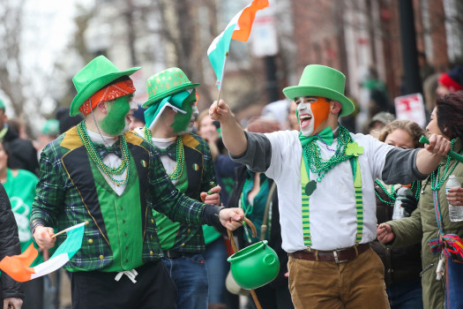
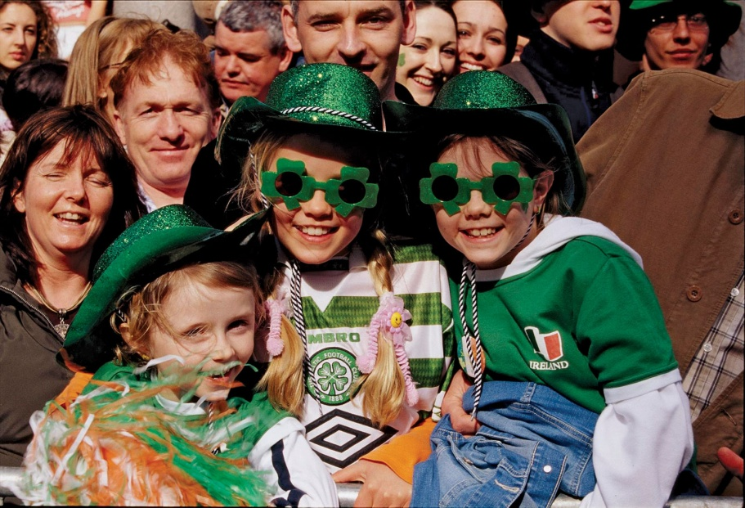
Interesting Facts
The first parade was actually held in Boston, The United States of America in 1737.
Shamrocks are the national flower/emblem of Ireland.
The real St. Patrick wasn’t Irish. He was born in The Great Britain.

Slide 5
Here are some videos that I personally find interesting, I hope you‘ll like them as well.
https://youtu.be/DgnLsfqIzTE
https://youtu.be/mfrwReAi-3k

Slide 6
Thank you For your Attention!
Have a nice Saint Patrick‘s Day!

